Slide 1
CFA Resource Tracking System (RTS)
Presentation thanks to Shane Peacock Program Director, ICT Communications

Slide 2
Why RTS?
The safety of CFA members is one of CFA’s highest priorities and the appropriate use of technology is one mechanism that can be employed to enhance CFA member safety.
The need for this capability was recognised by CFA and highlighted in the 2009 Bush Fires Royal Commission report.
More than 3,300 CFA vehicles are currently fitted with a GPS capable radio.

Slide 3
Benefits of RTS
The position of personnel with respect to hazards will be more precisely known.
Location of all Appliances deployed or not deployed will be shown on a common mapping system.
Incident controllers will gain better knowledge of resources deployed to incidents.
The situation of Appliances at Staging Areas and fireground sectors will be better known.
The exact count of deployed resources will be better known for logistics purposes.
Appliances that arrive early or leave suddenly from an incident can be better accounted for.

Slide 4
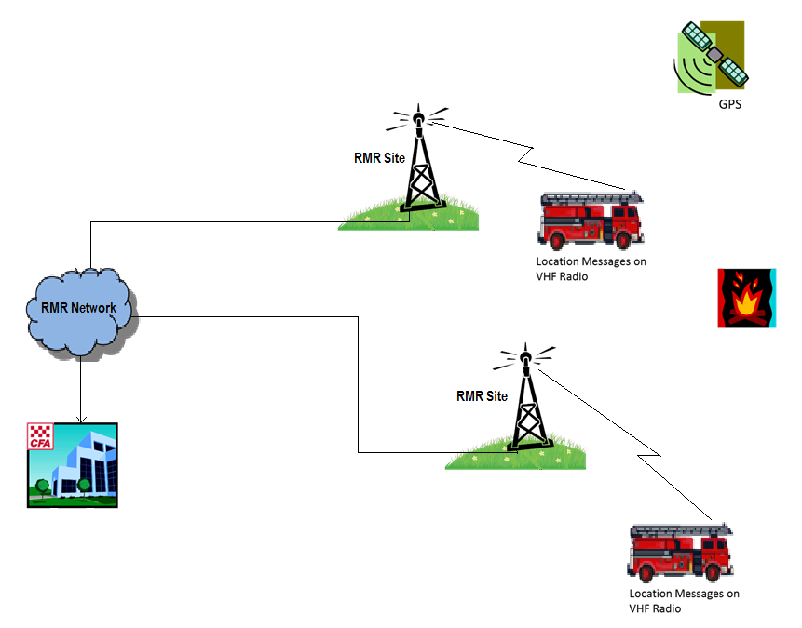
Location Service on Dispatch Channels

Slide 5
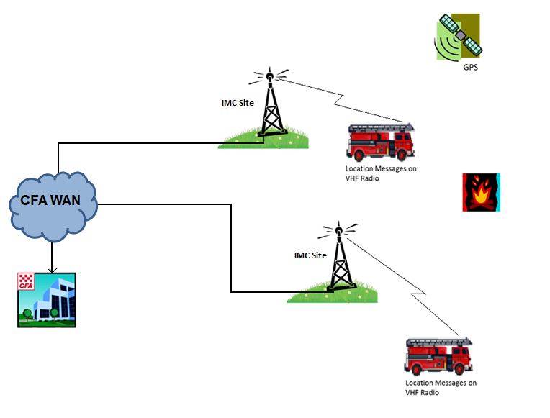
Location Service on Command Channels

Slide 6
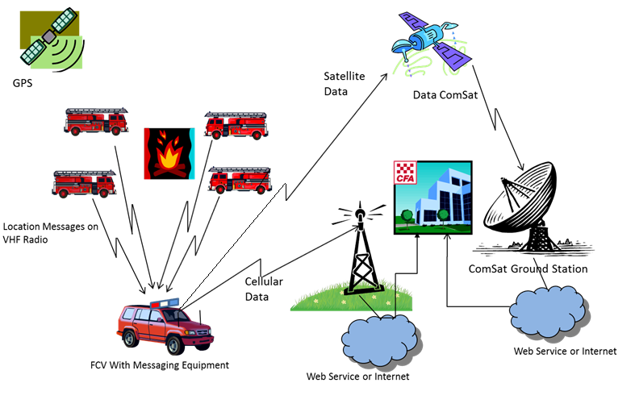
Location Service on the Fireground

Slide 7
GPS location messages from Tait Radios
Radios are not “polled”
The radio automatically transmits location data at preset triggers
Startup
While stationary
Vehicle comes to a stop
Regular intervals depending on vehicle speed
Location data can be manually triggered
Duress

Slide 8
RTS Display Systems
EMCOP – Managed by EMV https://prod.cop.em.vic.gov.au/sadisplay/nicslogin.seam
Require a members.cfa.vic.gov.au or cfa.vic.gov.au email address
eMap – Managed by DELWP https://emap.ffm.vic.gov.au
RTS Viewer (only available to OO & above)
https://rts.cfa.vic.gov.au
Note: Ops Cars are only visible on EMCOP & eMap if attached to an Incident.

Slide 9
RTS Data
Data Available In Systems
Latitude, Longitude, Heading
Position Time
Incident Number – if vehicle is responding or associated with an incident
Brigade Number of Vehicle
Brigade Name of Vehicle
Resource Name
Resource Short Name
Resource Aerial ID
Registration
District
Resource Category
Resource Type
Channel
Radio Alias
Data Source
Strike Team Name
Strike Team Short Name

Slide 10
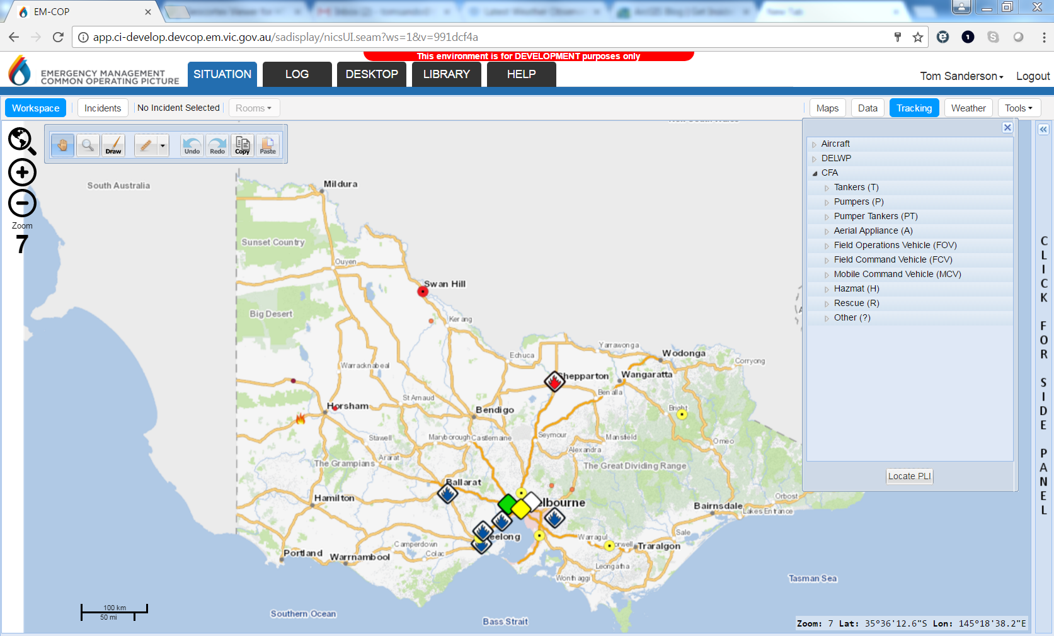
EMCOP

Slide 11
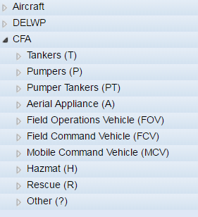
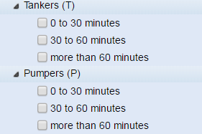
EMCOP
CFA Appliance Categories
Appliances are shown by type and last known time
0 – 30 minutes
30 to 60 minutes
Greater than 60 minutes
Appliance types are from RMS

Slide 12
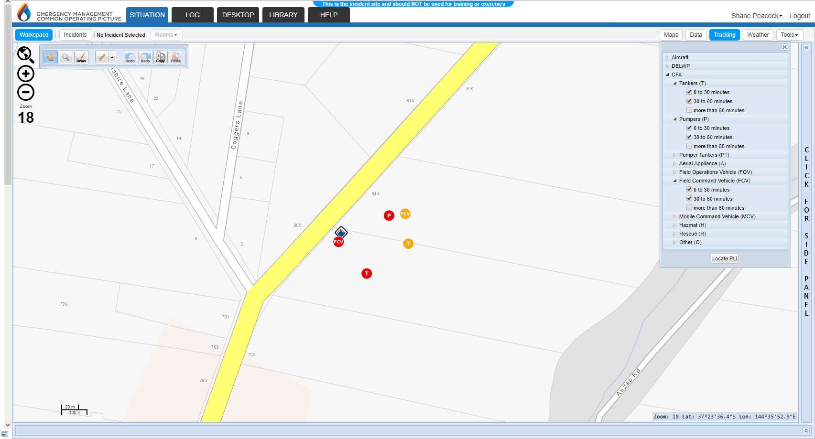
EMCOP

Slide 13
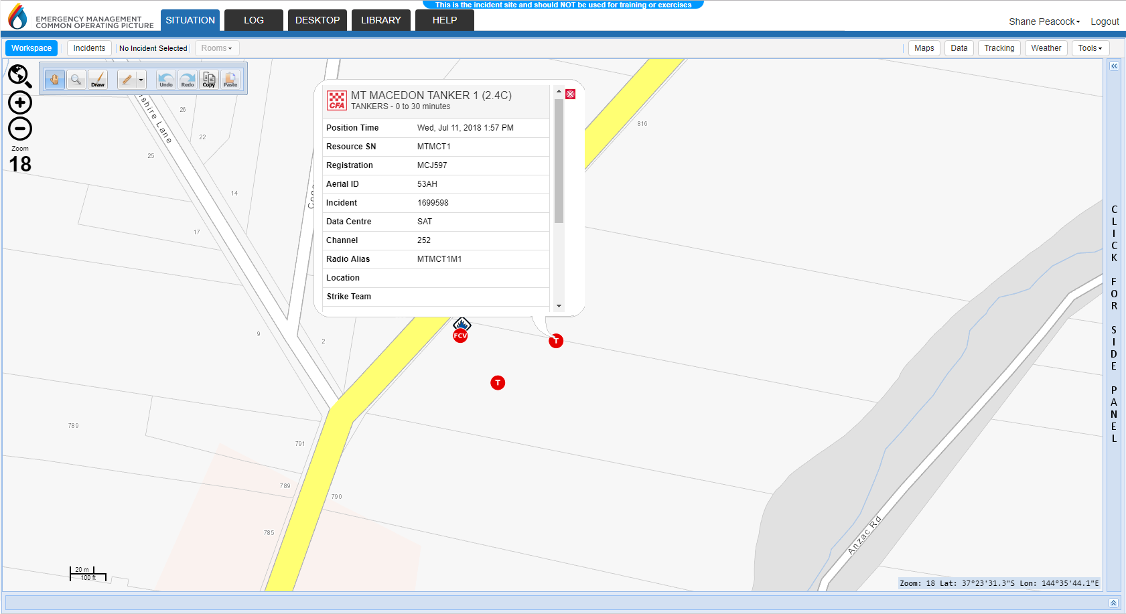
EMCOP

Slide 14
Resource Tracking System
For further information:
www.cfa.vic.gov.au/resourcetracking

